Slide 1

Intro to
Programming
With python
Files:
Part II
Monday, April 7 2025 TOH210
Notes:
Layout objects pulled from: https://slidesgo.com/
All icons are from: https://thenounproject.com/

Slide 2

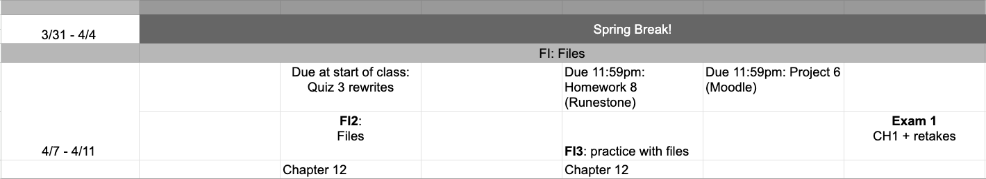
This week
google sheet link
Exam 1 this Friday (entire class period)
Second attempt on standards from Quizzes 1-3, and first attempt on first challenge standard CH1. Suggestions for studying: review slide decks; redo workbook exercise; solve problems by hand, then type into IDLE to check work; attend TA help sessions and/or office hours
Notes:
https://docs.google.com/forms/d/e/1FAIpQLSe3OloPAJSid4n6cyU_4qXpRWU7FOSmP7IVdRS_vh9cvYd9zQ/viewform?usp=sharing

Slide 3
Takeaways from last time
opening and closing a file using open and close
reading in a file using read
splitting long string into list using split
counting characters and words using len
finding count of single word using count

Slide 4


For this exercise, you’ll work with the file the_hobbit.txt. You can use the Python file you created last time (hobbit_file.py)
warm-up
Add code to do the following:
Find and print the number of characters in the file that are not spaces.
Find and print the number of times the word “wizard” occurs in the file.
[optional] Find and print the most common letter in the file.
hobbit_file = open("the_hobbit.txt", "r")
hobbit_text = hobbit_file.read()
hobbit_words = hobbit_text.split()
hobbit_file.close()
#information
num_char = len(hobbit_text)
num_words = len(hobbit_words)
#your code here
#a
#b
#c

Slide 5
creating file objects
opens a file in read mode
file = open("file_name.txt", "r")
opens a file in write mode
file = open("file_name.txt", "w")
closes the file– super important!
file.close()
convert to string
converts file object to one looong string
file_string = file.read()
convert to list of words
converts long string to list of words
word_list = file_string.split()
today
start today, use more when we cover csvs
writing files
adds string to file
file_object.write(string)
convert to list of lines
returns list where each item is a line from file
file_object.readlines()

Slide 6
writing multiple lines
Suppose you want to write multiple lines to a file
text_file = open("text_lines.txt", "w")
text_file.close()
text_lines = ["first line\n", "second line\n", "third line\n"]
text_lines = ["first line", "second line", "third line"]
for line in text_lines:
text_file.write(line)
To make it go to a new line, we need a special character called the newline character \n which we add at the end of each of the items in text_lines.
If we execute the code above, and then open text_lines.txt we will see:
first linesecond linethird line
first line
second line
third line
Notice there is no spacing here! That is because these items are essentially being glued together by the write method

Slide 7
Escape characters
There are some characters that we’d like to include in Python strings, but we can’t type normally.
We can use these as long as we use what are called escape characters, which always start with a backslash
\n newline character
\t tab
\" double quote
\' single quote
\\ backslash
you’ll add these to the string items in the list to help format your output

Slide 8
Exercise
Write a program that writes the following to a file snooze_bunny.txt
(\(\ ~zzzzz~
( -.-)
o_(")(")
pic = open( , "w")
lines = [ ]
for line in lines:
pic.write(line)
pic.close()
Note:
special characters need an escape character \ added before
tab \t and newlines \n should be added
write the first line and then execute to see if it works. If yes, add next line to lines list

Slide 9
[Optional] Alternative way to work with files:
with open("file_name.txt", "r") as hobbit_file:
hobbit_text = hobbit_file.read()
hobbit_words = hobbit_text.split()
print(len(hobbit_words))
Produces the same results as:
hobbit_file = open("file_name.txt", "r")
hobbit_text = hobbit_file.read()
hobbit_words = hobbit_text.split()
print(len(hobbit_words))
hobbit_file.close()

Slide 10
readlines
The file method readlines gives us another option for reading from a file, returning a list of all the lines from the file
bunny = open("snooze_bunny.txt", "r")
bunny_lines = bunny.readlines()
(\(\ ~zzzzz~
( -.-)
o_(")(")
would give us the list:
[" (\\(\\\t~zzzz~\n", " ( -.-)\n","o_(\")(\")"]

Slide 11

before next time
Finish workbook

Slide 12
pic = open("snooze_bunny.txt", "w")
lines = [" (\\(\\\t~zzzz~\n",
" ( -.-)\n",
"o_(\")(\")"]
for line in lines:
pic.write(line)
pic.close()

